Slide 1

OOP Concepts
Object oriented programming

Slide 2
Summary
https://www.w3schools.com/cpp/cpp_oop.asp

Slide 3
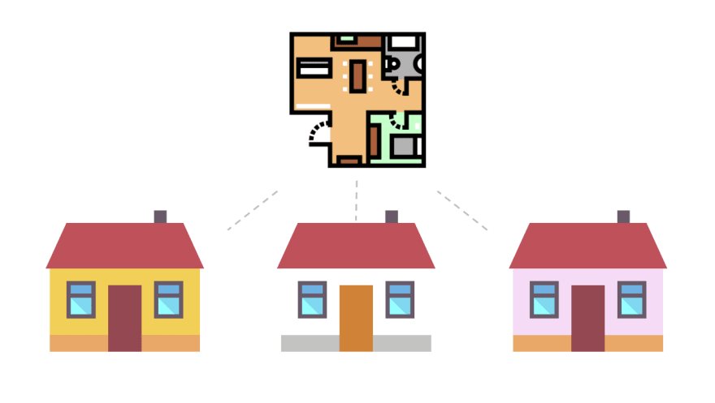
Class
A blueprint for creating an object
Class House
House 1
House 2
House 3

Slide 4
Object
An instance of a class
3 yellow, white & pink houses are 3 instances created from the blueprint of a house

Slide 5

What does a class have?
Attributes (data)
Behaviors (functions)
Attributes: weight, height
Behaviors: eat, sleep, run
When a cat eats, what changes?
When a cat sleep, what changes?

Slide 6

Behaviors can change attributes
eat
sleep

Slide 7
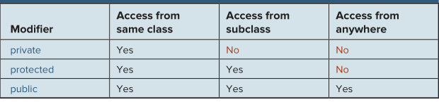
Visibility
Private: open to no class
Public: open to all other classes
Protected: open to only child classes

Slide 8
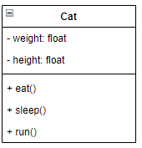
Represent a cat with UML
Universal Modeling Language – Class diagram
Attributes
Behaviors
https://en.wikipedia.org/wiki/Class_diagram

Slide 9
Questions
The second section is for private things only & the third section is for public things only?

Slide 10
Exercises - Create class diagram for
A Soldier that has Hit points and Mana, can attack and defend
A Fraction that has a numerator and a denominator
A Point in 2D space, with x and y location
A Line in 2D space, created by 2 points
A Circle in 2D space, with radius and a center, Pi=3.14
A Rectangle in 2D space, with width and height
A Square in 2D space, with a side
A Triangle in 2D space, with 3 sides’ length
A Dice, could be 4/6/8/10/12/20 faces
A Student that has ID, Fullname, Telephone, Email

Slide 11

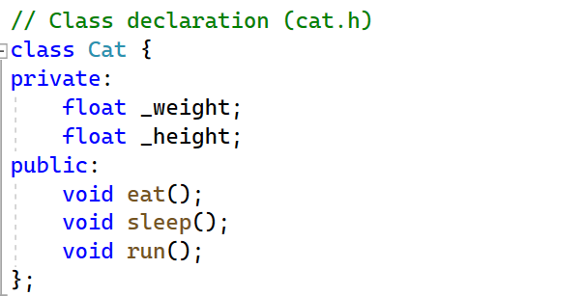
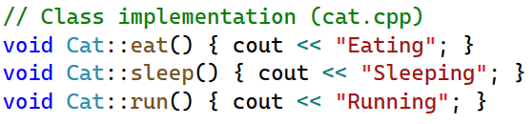
C++ Coding

Slide 12
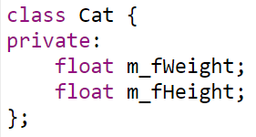
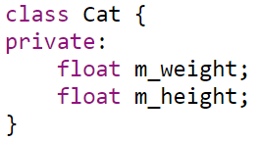
Other coding standards
Hungarian notation
Google style - Trailing underscore
float weight_;
float height_;
Google C++ Style Guide

Slide 13
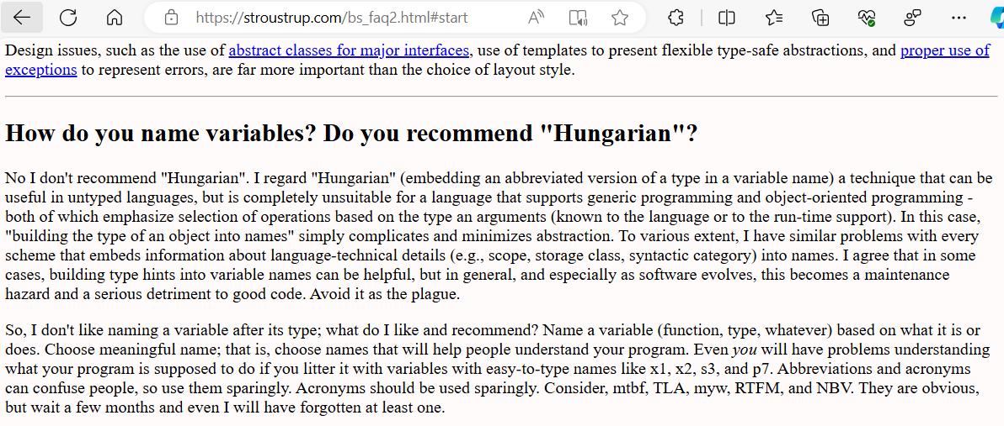
C++ author’s opinion on Hungarian notation

Slide 14
Which coding standard to use?
Really depends on
Customer’s requirement
Language / Project
Team / Company
Chosen in this course:
_camelCase: private attribute
camelCase: public method // updateInfo(), changeName()
PascalCase: Classname // OrderDetail, BasicSettings
ALL_UPPERCASE: constant

Slide 15
Exercises
Identify classes from daily apps:
Gmail
Facebook
Tiktok
Youtube (insights)
Steam
Genshin Impact
DOTA / League of Legend
Chess game
Tetris game
eCommerce (shopee / lazada / tiki / thegioididong)
WorldCup

Slide 16
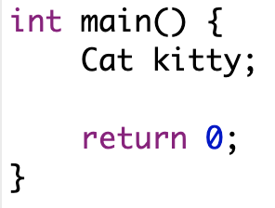
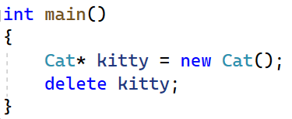
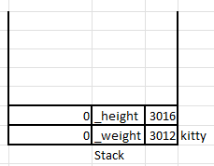
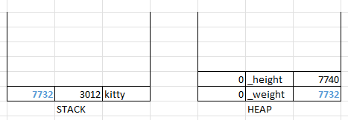
Object life cycle

Slide 17
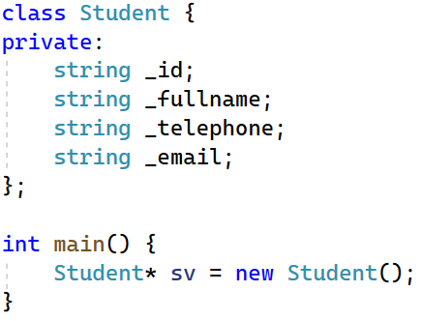
Exercise
Suppose we have a Student class: ID, Fullname, Telephone, Email
Try to illustrate what happens in the stack and heap when writing this code:

Slide 18
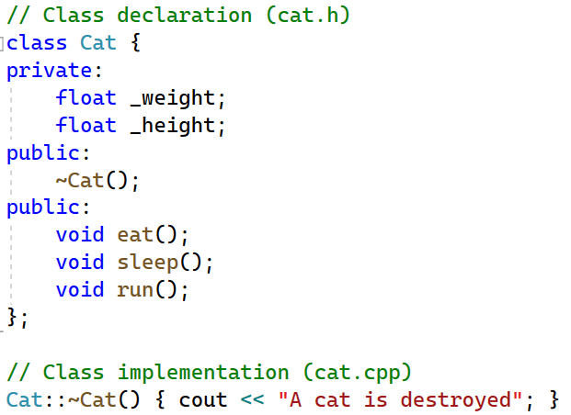
Question?
How do we know the object is destroyed?
=> Destructor

Slide 19
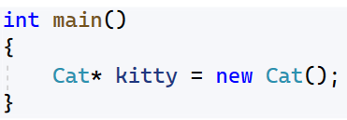
Memory leak
Why?
Solution?

Slide 20
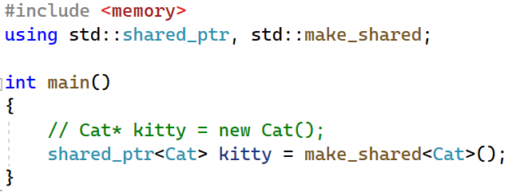
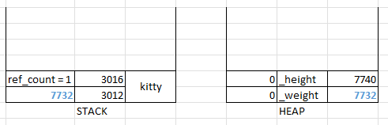
Smart pointer
Other types of smart pointers: unique_ptr, weak_ptr

Slide 21
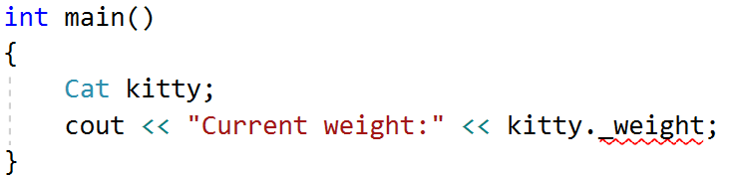
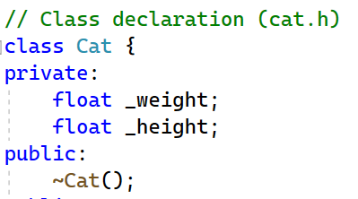
How to know the cat weight?
This code will produce error
“Cat::_weight': cannot access private member
Why?

Slide 22
Getter & Setter
For now, there are two types of scope for attributes & behaviors
Private: can be accessed inside class
Public: can be accessed from anywhere
To access private attributes, we should use getter & setter

Slide 23
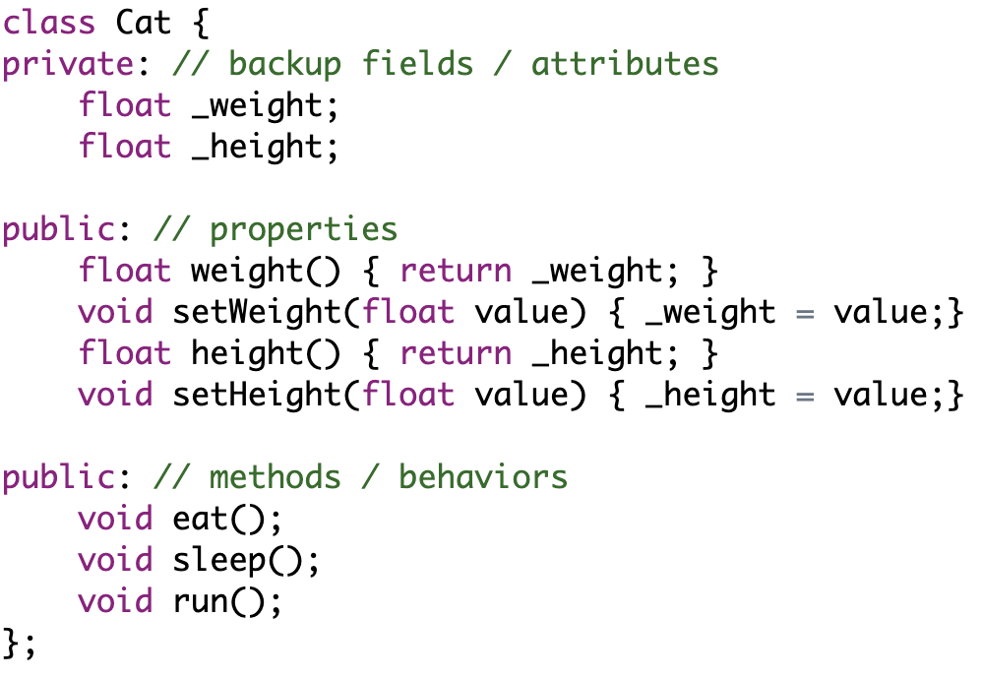
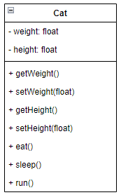
Coding for getter & setter
encapsulation
: state should be changed by members

Slide 24
Modern approach
Function should start with a verb
getWeight(), getHeight()
What if it starts with a noun?
weight(), height()
=> We understand that it is a property (a getter)

Slide 25
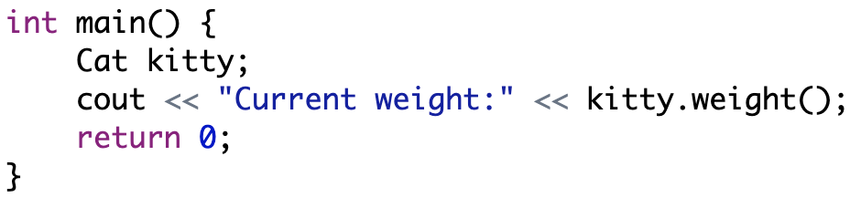
Now we can know the cat’s weight!
We haven’t set intial value yet!

Slide 26
Constructors

Slide 27
Constructor
Object needs to initialize its values in constructor
Fraction class: denominator should not be 0
Or do some setup procedure
RandomIntegerGenerator: do the seeding

Slide 28
What is special about constructor?
Same name as class
Class Fraction has constructor Fraction ()
Has no return type
Only write, no void needed!
Fraction () {
}
Is called when an object is created!

Slide 29
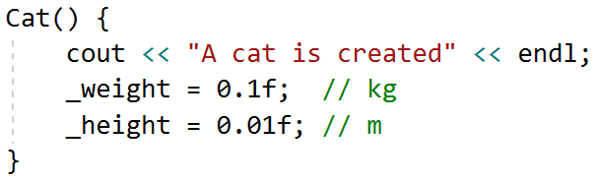

Example – Constructor will be called automatically
Let’s modified the constructor

Slide 30
What will happen if there is no constructor?
An empty constructor will be created for you
Actually, there are a lot of constructors that will be created automatically for you (will be shown later in this course)
Exception: if you provide a constructor with parameters, default constructor won’t be created automatically
Does constructor always succeed?

Slide 31
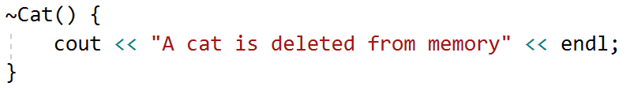
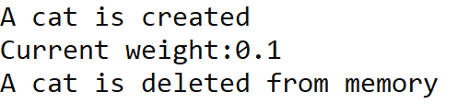
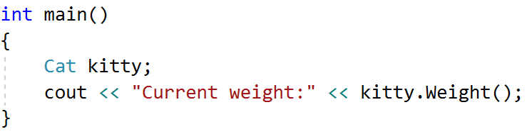
Destructor
Together with constructor, there exists destructor
Will be called befored an object is deleted

Slide 32
What do we do on constructor & destructor?

Slide 33
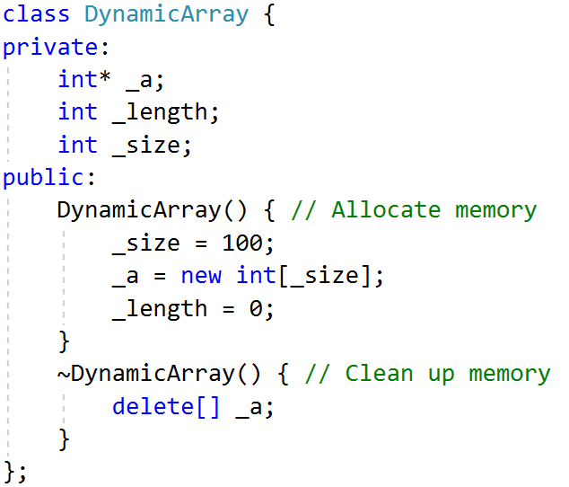
Dynamic array – Manual implementation
Pre allocate memory

Slide 34
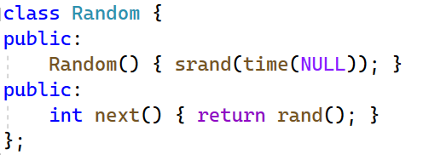
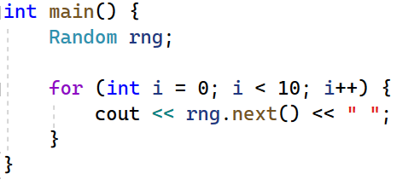
Random class
Initialize using a seed

Slide 35
Dice class
Create a class that represent a Dice
Print out 10 results of the dice rolling
This Dice class could use some help from the Random class built above

Slide 36
What about 3 dices?
Suppose you have 3 dices. Each time roll these 3 dices and print out the results.
What is the problem here?

Slide 37
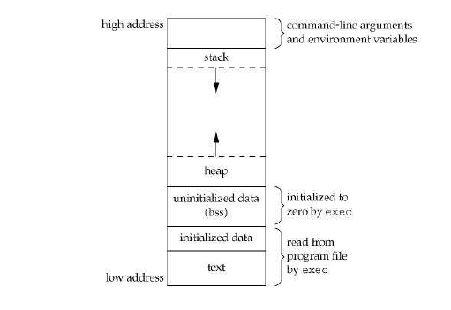
Where are static variables stored?

Slide 38
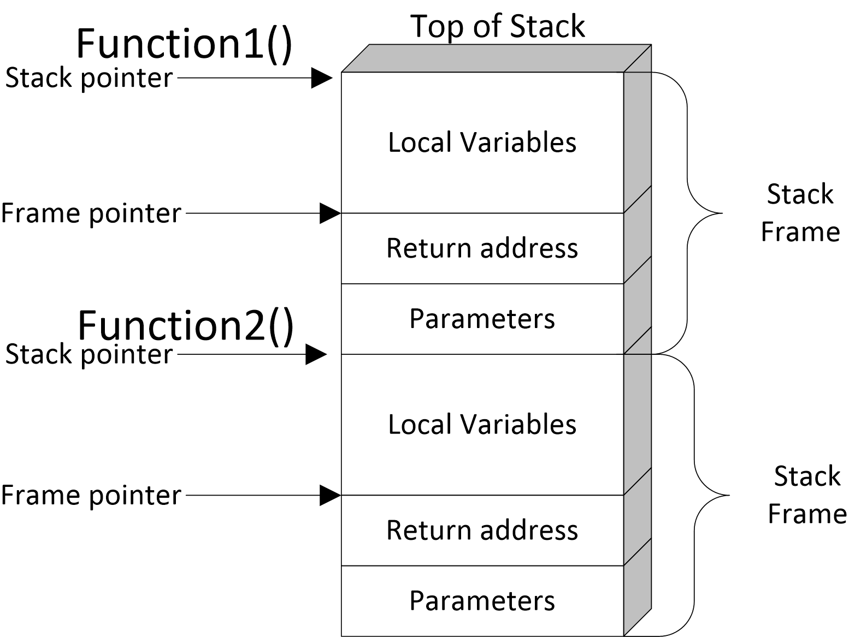
Function call stack - Stack frame
https://webframes.org/what-is-a-stack-frame-and-why-it-so-important/

Slide 39
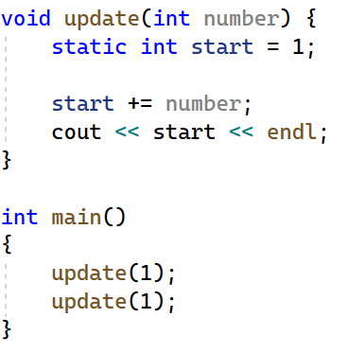
Static variable inside a function

Slide 40
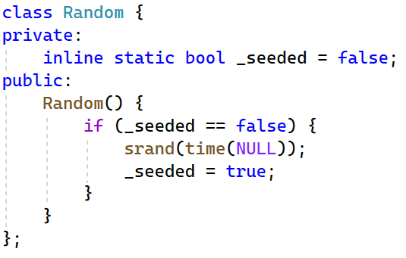
Improvement for Random class

Slide 41
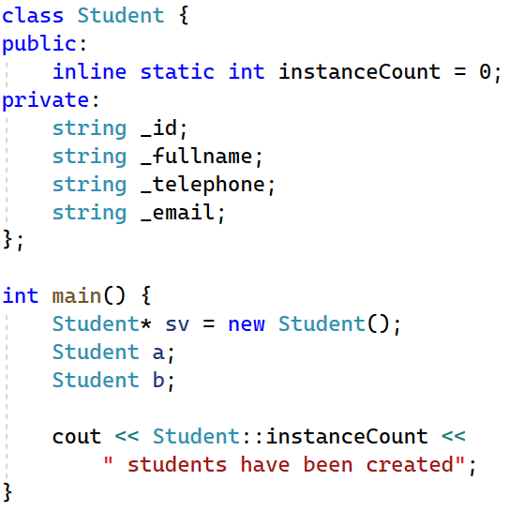
Exercise
Count the number of instances of the class Student
Write the missing code
Default value?
Count instances?

Slide 42
Common obvious questions
Why do we need to write getter & setter?
Short answer: it depends on the business requirement
Let’s take a look on some common examples

Slide 43
Getter types

Slide 44
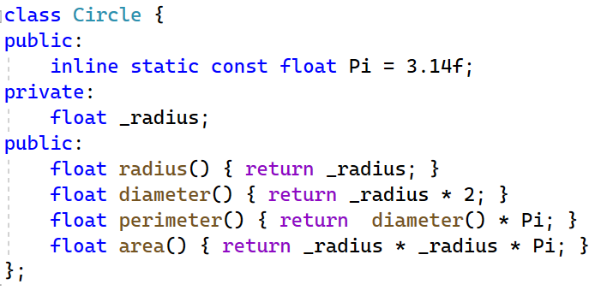
Derivative properties
Created from another attributes

Slide 45
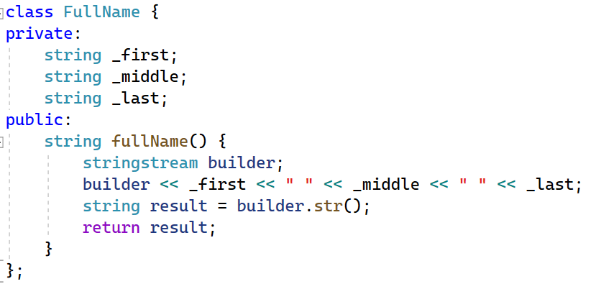
Combination from other atributes

Slide 46
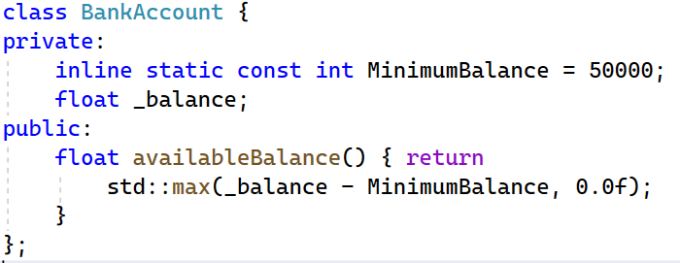
Getter with business logic
How about divisible by 50.000 at ATM?

Slide 47
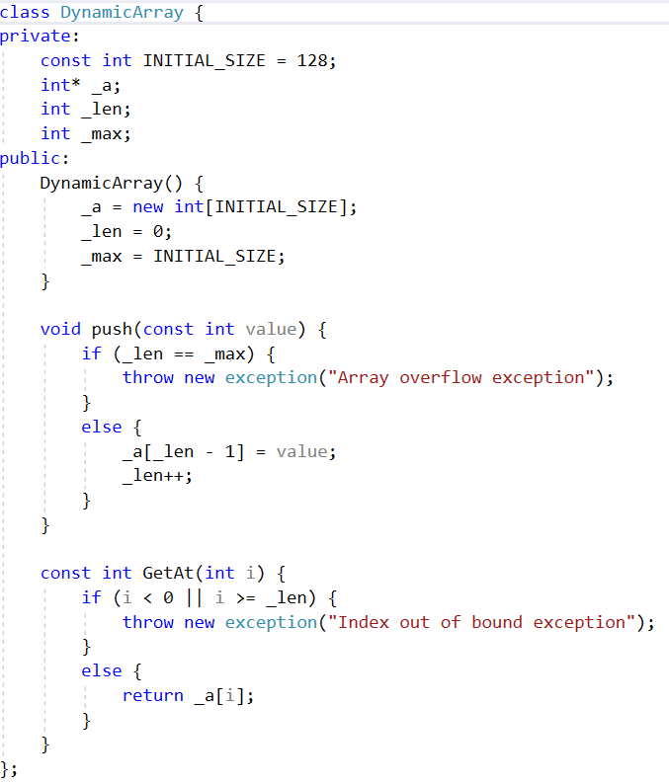
Validation

Slide 48
UI approach (WP)
UI & data synchronization (INotifyPropertyChanged)
Later course: Windows Programming

Slide 49
Exercise
bool withdraw(ATM& atm, BankAccount& acc, int amount) {
if (amount > acc.available()) {
cout << “So du tai khoan hien tai khong du” << endl;
return false;
}
if (amount > atm.available() {
cout << “So tien vuot qua tien may co the tra” << endl;
return false;
}
if (amount % 50.000 != 0) {
cout << “May chi co the tra tien la boi so cua 50.000” << endl;
return false;
}
acc.withdraw(amount);
atm.withdraw(amount);
return true;
}

Slide 50
Parameterized constructor

Slide 51
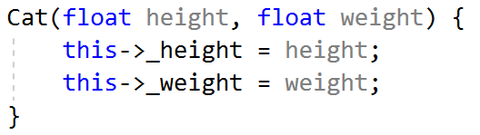
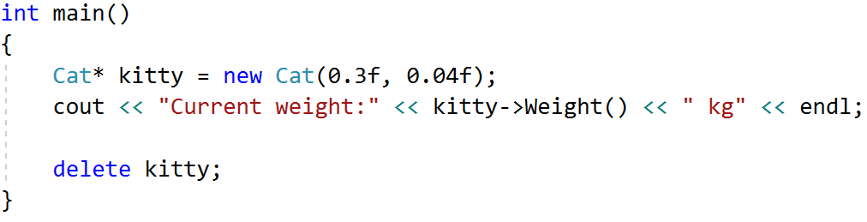

Parameterized constructor
What if we want to set the value manually for each attributes?

Slide 52
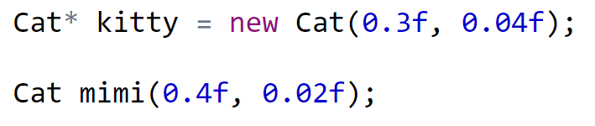
Two ways to used parameterized constructor

Slide 53
What if we want to use 12 faces dice?
It should be better to write
Dice dice1; // default 6 faces dice
Dice dice2(12); // 12 faces dice
Dice dice3(24); // 24 faces dice

Slide 54
Object serialization

Slide 55
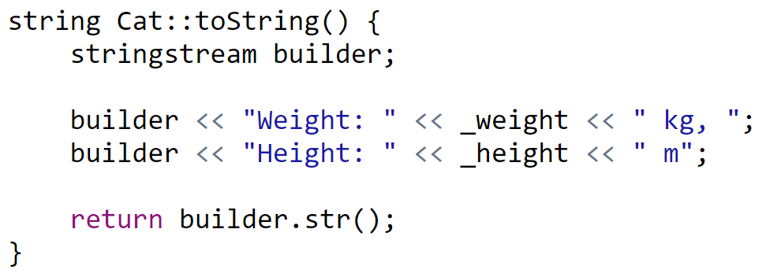
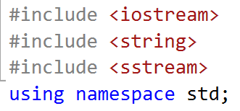
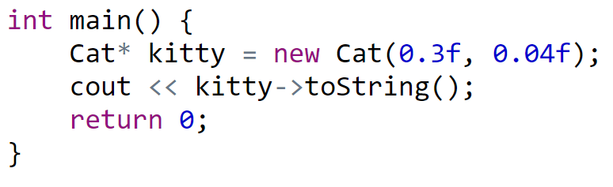

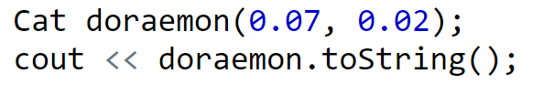
toString
Simple example to simplified serialization

Slide 56
How about fraction?
There are many ways to print out the fraction 10/6
“as is”: 10/6
Simplified / lowest term: 5/3
Mixed: 1 2/3
Decimal with precision of 3: 1.666
Percentage with precision of 1: 166.6%
Solution: Converter

Slide 57
Doxygen

Slide 58
Doxygen: Generate documents from comments
$ sudo apt install -y doxygen graphviz
Create Doxyfile by
$ doxygen -g
Open this file and edit

Slide 59
Edit Doxyfile
PROJECT_NAME = “Book renting”
EXTRACT_ALL = YES
GENERATE_LATEX = NO
INPUT = "./"
INPUT += "../lib"
RECURSIVE = YES
HTML_OUTPUT = docs

Slide 60
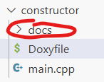
Running doxygen
$ doxygen Doxyfile

Slide 61
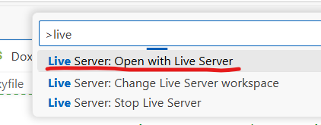
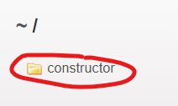
Viewing documents
Extension: Live server. Open file docs > index.html
Ctrl + Shift + P >

Slide 62
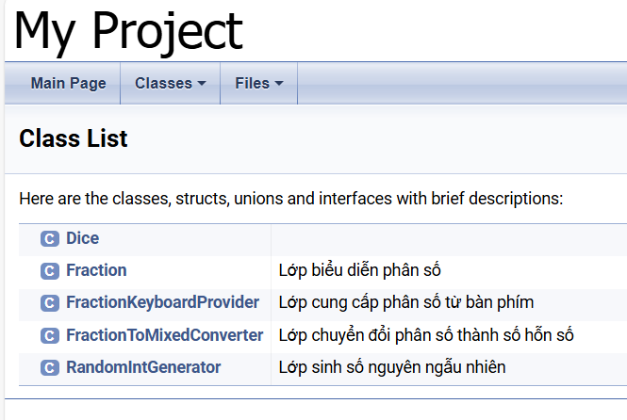
What to expect?

Slide 63
Copy constructor

Slide 64

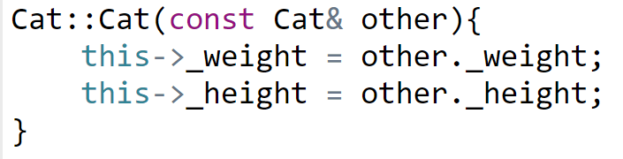


Declaration & Implementation

Slide 65
Actually
Without writing copy constructor, the below code still works
The compiler will automatically generate copy constructor for us
So when do we actually need to implement copy constructor?

Slide 66


Problem with default copy constructor
Shallow copy

Slide 67

What happen on stack?

Slide 68

Deep copy
This is why we need copy constructor

Slide 69

Assignment operator
Again, the automatically generated assignment operator is the problem

Slide 70


Implement assignment operator

Slide 71

Tricky situation
Copy constructor or assignment operator?
The answer is copy constructor

Slide 72
Rule of three
If a class define one of the followings, it should define all of the others
destructor
copy constructor
copy assignment operator

Slide 73
What if we want a dynamic array of string / Student / Point?
The code will be repetitive for
DynamicStringArray
DynamicStudentArray
DynamicPointArray
Is there a better approach?
Class template
Polymorphism

Slide 74
Function template

Slide 75


Why do we need function template?
Suppose we have one function that can operate on int
How about string? Let’s write another function
How about char? float? double? Student? Product?....

Slide 76





Function template – Definition & usage

Slide 77


True meaning of function template
We think we only write code once
Actually, we borrow the power of compiler to generate the code below for us

Slide 78
Class template
Same thing
template <classname T>
class DynamicArray {
private:
T* _elements;
};

Slide 79
Usage
DynamicArray<int> a;
DynamicArray<float> ratios;
DynamicArray<Fraction> types;
DynamicArray<Employee> interns;

Slide 80
Static members

Slide 81
Characteristics
Static members exist before class initialization
Can be accessed directly without any instance

Slide 82

Class Point

Slide 83


Usage

Slide 84

Class Circle

Slide 85

Shortcut to initialize static members
inline

Slide 86
Input & Output

Slide 87
Behind the scene of operator
swap(oldValue, newValue)
a + b
operator+(a, b)
2 + 8 + 10 + 11
operator+( operator+( operator+(2, 8), 10) , 11 )
4 * 3 – 2 / 1 + 16
operator+( operator-( operator*(4, 3), operator/(2, 1)) , 16)

Slide 88
Behind the scene of cin
cin >> x >> y >> z >> m;
operator>>(cin, x)
operator>>(cin, y)
operator>>(cin, z)
operator>>(cin, m)
istream& operator>>(istream& , int&)

Slide 89
Behind the scene of cout
cout << x << y << z << m;
operator<<(cout, x)
operator<<(cout, y)
operator<<(cout, z)
operator<<(cout, m)
ostream& operator<<(ostream& , int&)

Slide 90
What we want
Point* p = new Point() ;
cin >> p;
cout << p;
How to do it?
operator overloading

Slide 91

Input overloading

Slide 92
friend operator
Allow a non-member function can access the private and protected members of a class

Slide 93

Output overloading

Slide 94
Exercises
Point , Line, Rectangle, Triangle, Circle
Fraction
Time, Date
Random, Dice, DiceGame
DynamicArray
Student

Slide 95

Exercise
Given this main method
Design and implement class Fraction

Slide 96
Note
Where to put GCD function? Inside class Fraction or not?
Should the Plus function be static?
Should we overload operator+?
Do we need getter/ setter?
Do we need constructor & destructor?
Difference between swap(int*, int*) and swap(int&, int&)

Slide 97
Question?

